Slide 1

WEB CISC3003
A Deep Dive into RWD & Rate Limiting Strategies
CHANG I WAI, JOEY
DC325420

Slide 2



Stability and Usability: The Pillars
External: User-Centric RWD
Internal: System Integrity
Focusing on Task Completion across all devices (phones, tablets, and desktops) to ensure a seamless rental experience.
Implementing Rate Limiting to safeguard the server from crashes, accidental double-clicks, and malicious bot traffic.

Slide 3
Pillar I: Responsive Web Design
Moving beyond "resizing" to functional excellence

Slide 4
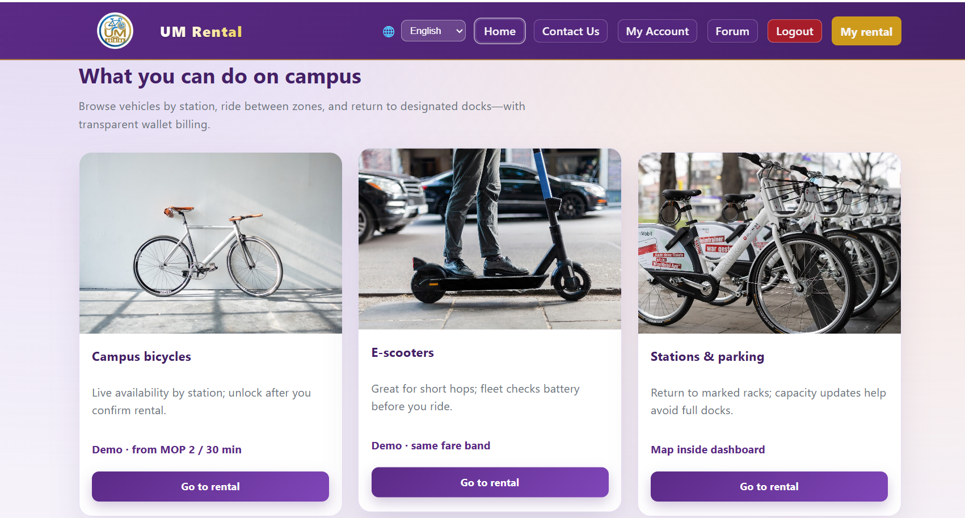
Designing for Task Completion
We prioritized the core user journey to ensure 100% functionality on small screens:
Secure & Clear Authentication
Real-time Vehicle Discovery
Seamless Rental Activation
Intuitive Order Management

Slide 5






Strategic Layout Management
Mobile-First
Fluid Grids
DRY Code
Most important action buttons prioritized at the top for vertical thumb-scrolling efficiency.
Content reshuffles from side-by-side (Desktop) to top-to-bottom (Mobile) without losing context.
Shared style sheets ensure visual consistency and easy future scalability across the codebase.

Slide 6
Pillar II: Rate Limiting
The invisible gatekeeper of system performance

Slide 7
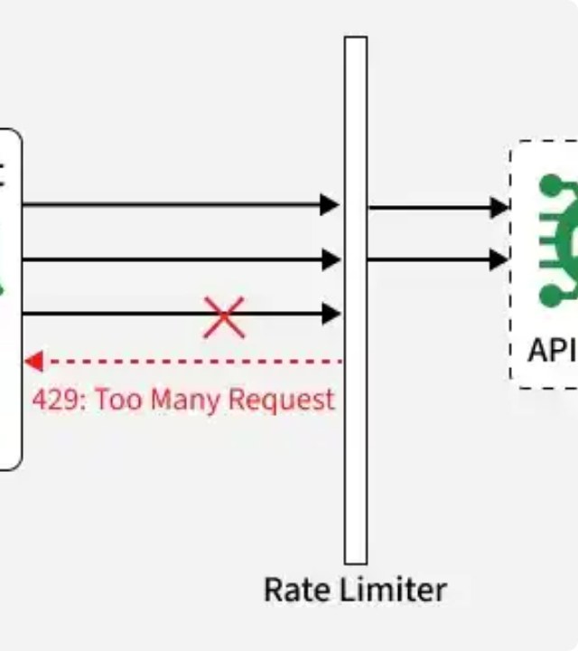
The Strategic Security Gate
Rate limiting serves as our first line of defense, checking request frequency before they ever hit the core application logic.
Early Detection: Identifies rapid-fire clicks instantly.
Throttling: "Wait a moment" messaging for safety.
Resource Guard: Keeps the server efficient.

Slide 8
Protecting Critical Infrastructure
Protected Action | Potential Risk | Mitigation Strategy
Login Requests | Brute Force / Credential Stuffing | Exponential back-off for failed attempts.
"Rent Now" Clicks | Accidental double-clicks / Race conditions | Request throttling per user session.
API Dashboard Load | Bot Scraping / Excessive Refreshing | Fixed-window rate limiting on API endpoints.

Slide 9
Synergy: User & Server Harmony
Total Quality Management
99%
RWD clarifies the interface, reducing user error and "panic clicks." Rate limiting catches the remaining edge cases.
Result: A "Super Strong" application that handles high traffic gracefully while remaining effortless for the end user.
System Stability

Slide 10
Technical Project Repository
Category | Key Files / Evidence | Core Logic
RWD / CSS | style.css, dashboard.css, login.css | Media queries, Flexbox, Adaptive Layouts
Rate Limiting | config.php, api/login.php, rental_action.php | Throttling logic, Action protection gates
API Protection | api/dashboard_api.php, api/_common.php | Centralized request filtering chain

Slide 11




Image Sources
https://cdn.dribbble.com/userupload/44859014/file/6fbfc3b2c2695646ca123b6b8c01aad9.png?crop=0x0-2395x1796&format=webp&resize=400x300&vertical=center
Source: dribbble.com
https://media.geeksforgeeks.org/wp-content/uploads/20260331153020903963/what_is_rate_limiting_11.webp
Source: www.geeksforgeeks.org
https://d3njjcbhbojbot.cloudfront.net/api/utilities/v1/imageproxy/https://images.ctfassets.net/wp1lcwdav1p1/3Hza57OTLRJzS2w69oT7VJ/97e92e9f54b741d95208463c97bd6fe9/GettyImages-2022975324.jpg?w=1500&h=680&q=60&fit=fill&f=faces&fm=jpg&fl=progressive&auto=format%2Ccompress&dpr=1&w=1000
Source: www.coursera.org
https://image.slidesdocs.com/responsive-images/background/business-dark-sense-of-technology-texture-blue-nature-powerpoint-background_ecd678c7a5__960_540.jpg
Source: slidesdocs.com

